Slide 1
Speak up! Brands’ Responsiveness Matters: Consumer Reactions to Brand Communications in the Early Stage of a Crisis
Tessa Garcia-Collart, PhD
Jayati Sinha, PhD

Slide 2
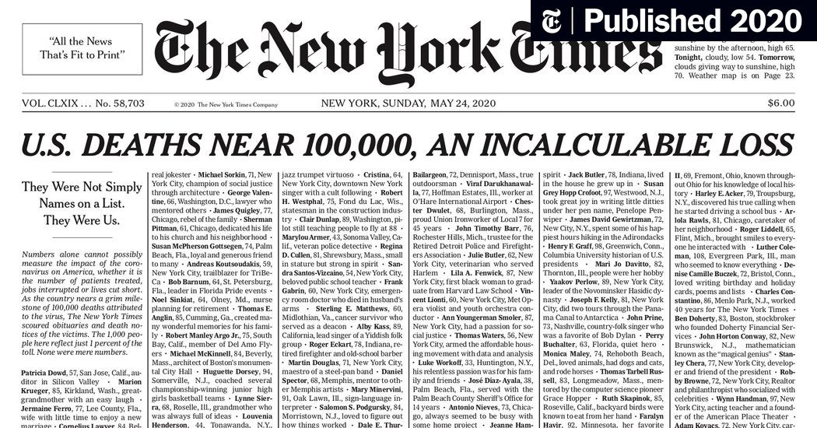
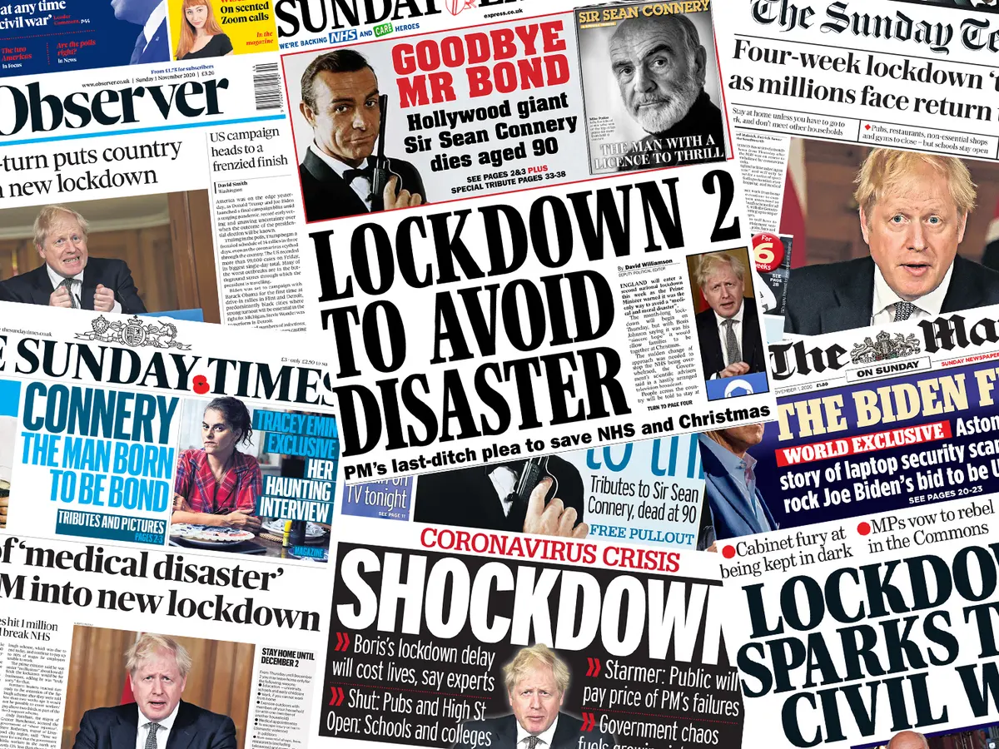
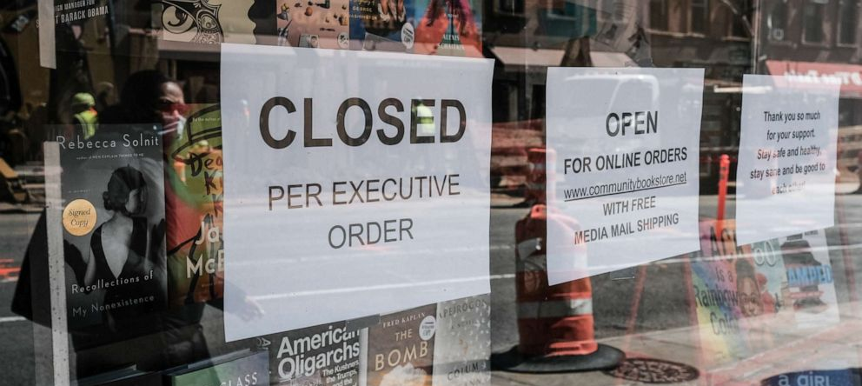
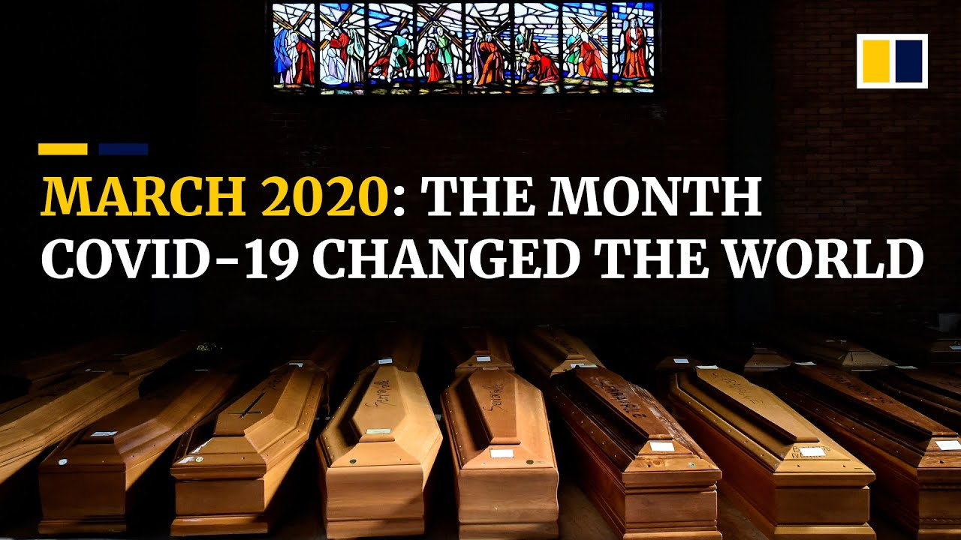
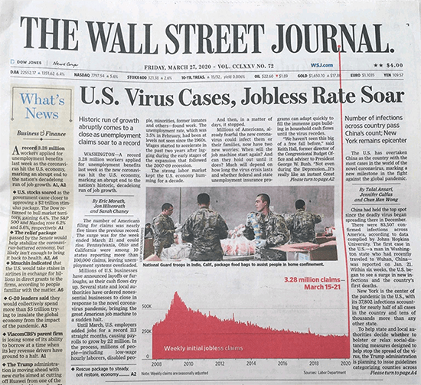
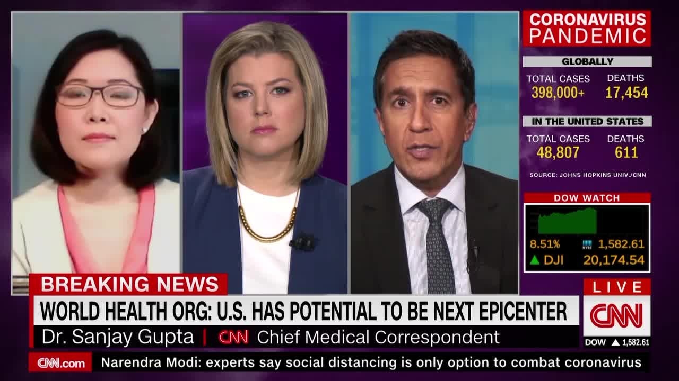
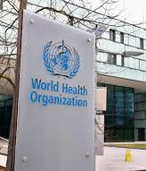
h Digital brand communications rose to the forefront of the crisis, as prime means by which brands connected with consumers h - Pantano et al. (2020)

Slide 3
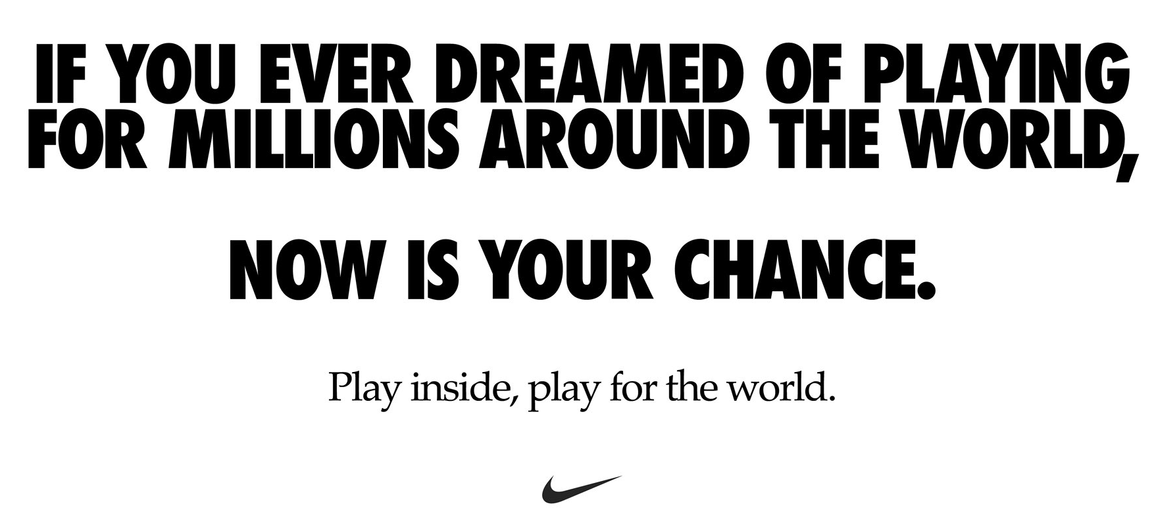
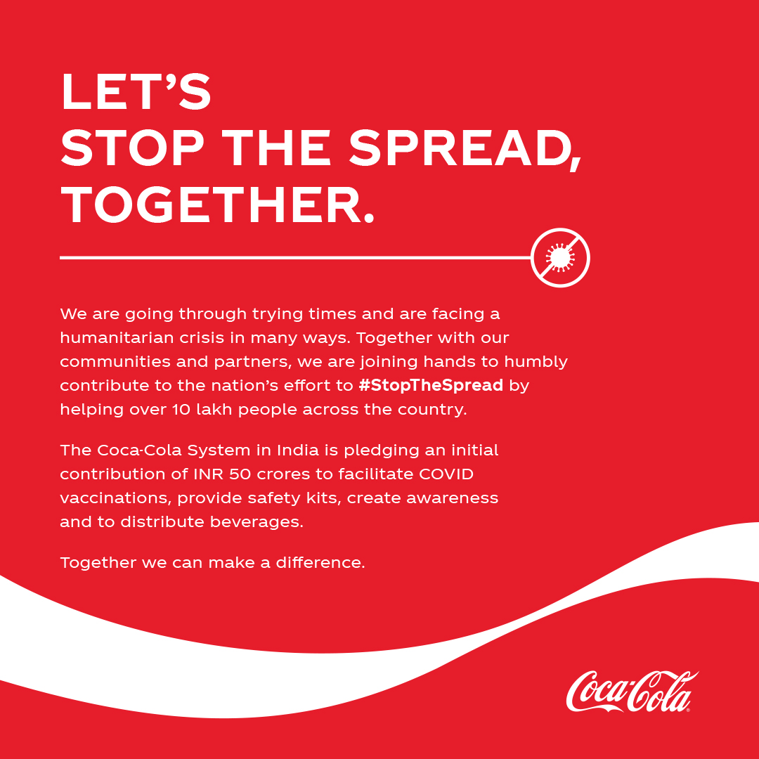
CRISIS RELATED ADS

Slide 4
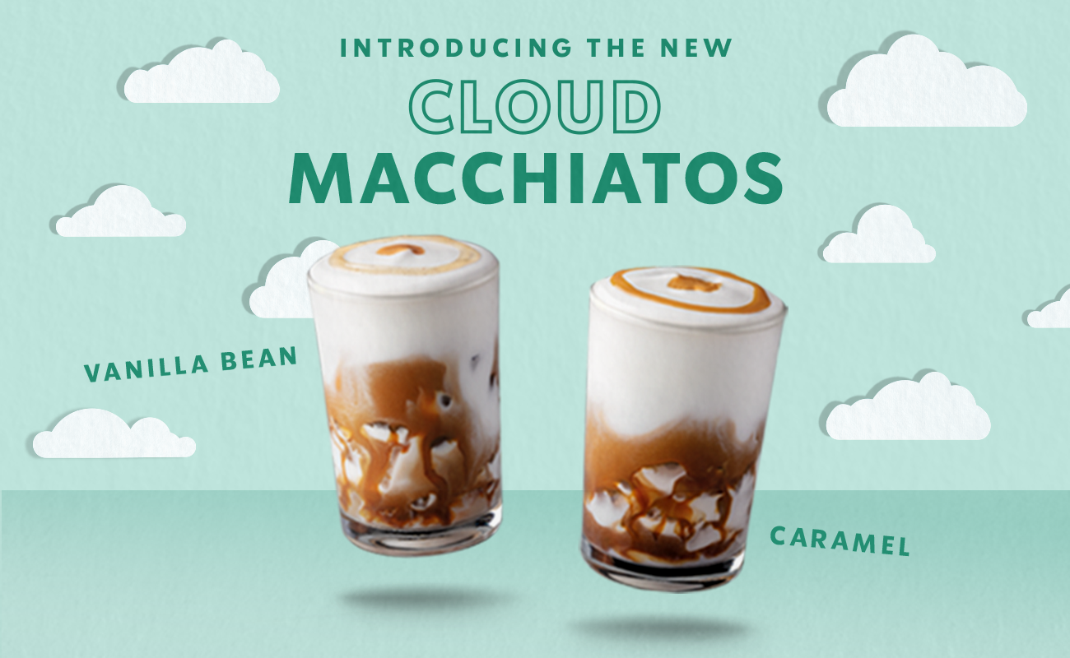
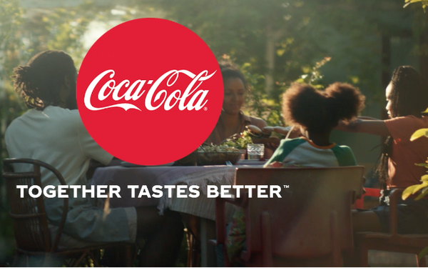
NON-CRISIS RELATED ADS

Slide 5
Which one during the
onset of a crisis?
Notes:
Highlight: CULTURALLY relevant approach as advised by World Health Organization (Facts on Obesity) and Thomas, Fine and Ibrahim, 2004.

Slide 6
Brand Communications:
A Strategic Process
Open interaction between brands and consumers about products, services, other
Occurs in different formats (social media, mobile, print, broadcast)
Increase brand equity, brand engagement, sales, brand awareness, brand loyalty, and brand image
Source: Batra & Keller (2016); Keller (2001); Keller (2009); Madhavaram, Badrinarayanan, & McDonald (2005)

Slide 7
Brand Communications:
During the onset of crisis
BC play a pivotal role during crisis management as a means of preserving brand equity (Cleeren, Dekimpe, & Helsen, 2008)
Consumer expectations that brands raise awareness of the crisis and demonstrate genuine concern for consumers’ wellbeing, specifically at the early crisis stages (Jones et al., 2010; Shi, 2020; Claeys & Cauberghe, 2014; Kirk & Rifkin, 2020)
65% of global consumers indicated that brands’ response to the coronavirus pandemic would influence their future purchases (Rogers, 2020)
During the onset of a crisis, consumers will react more favorably to brands’ crisis-related messages compared to non crisis-related messages, than their baseline brand attitudes, engagement, and self-brand connections.
H1
Notes:
Important: Persuasiveness of appeals directly linked to MESSAGE FRAMING

Slide 8
Brand Communications:
During Social Distancing
Social distancing lowers social connections, thereby increasing feelings of social isolation that have adverse effects on wellbeing (Cacioppo & Hawkley, 2009)
Since the need to belong is a primary human motive, when individuals’ social connections are impaired, they are motivated to seek and maintain social bonds (Baumeister & Leary, 1995; Walton, Cohen, Cwir & Spencer, 2012)
One goal of brand marketing communications is for brands to connect and engage with consumers in a bi-directional manner, as one would in human relationships (Fournier, 1998; Fournier & Avery, 2011)
Social connections will moderate the effects of brand messages on consumer reactions to the brand, such that consumers with lower (higher) social connections will react more (less) favorably to crisis-related (non crisis-related) messages.
H2
Notes:
Important: Persuasiveness of appeals directly linked to MESSAGE FRAMING

Slide 9
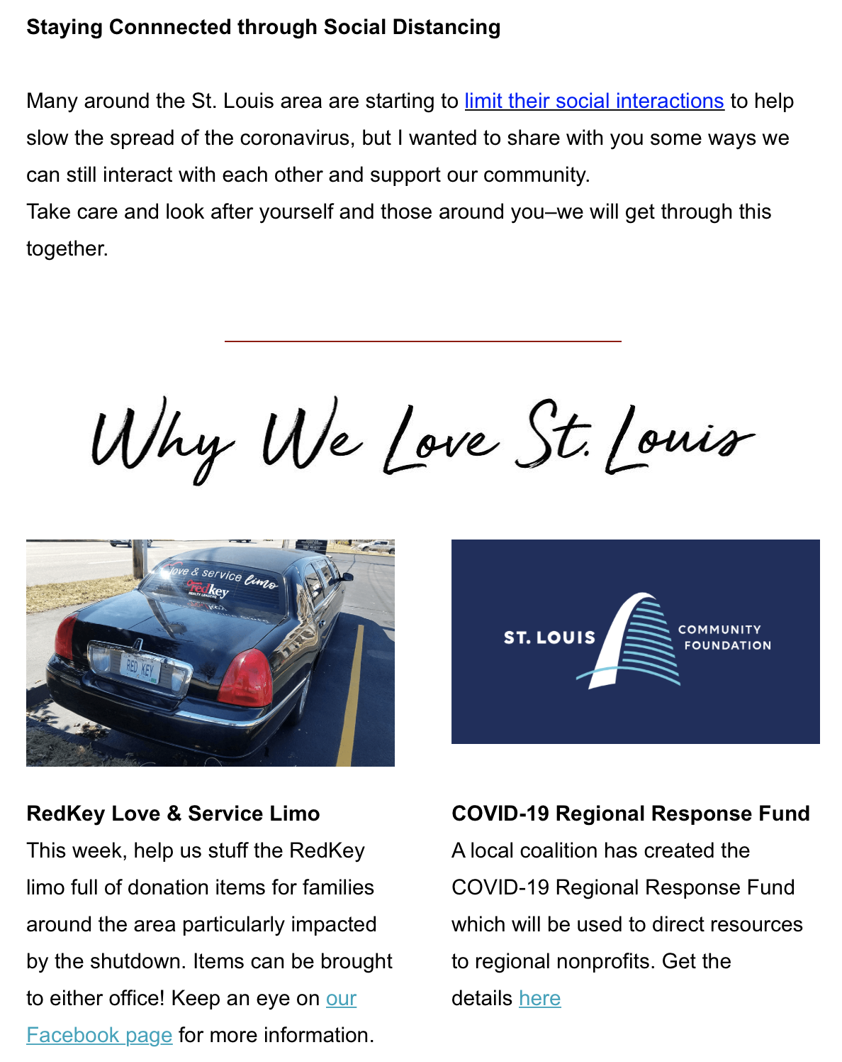
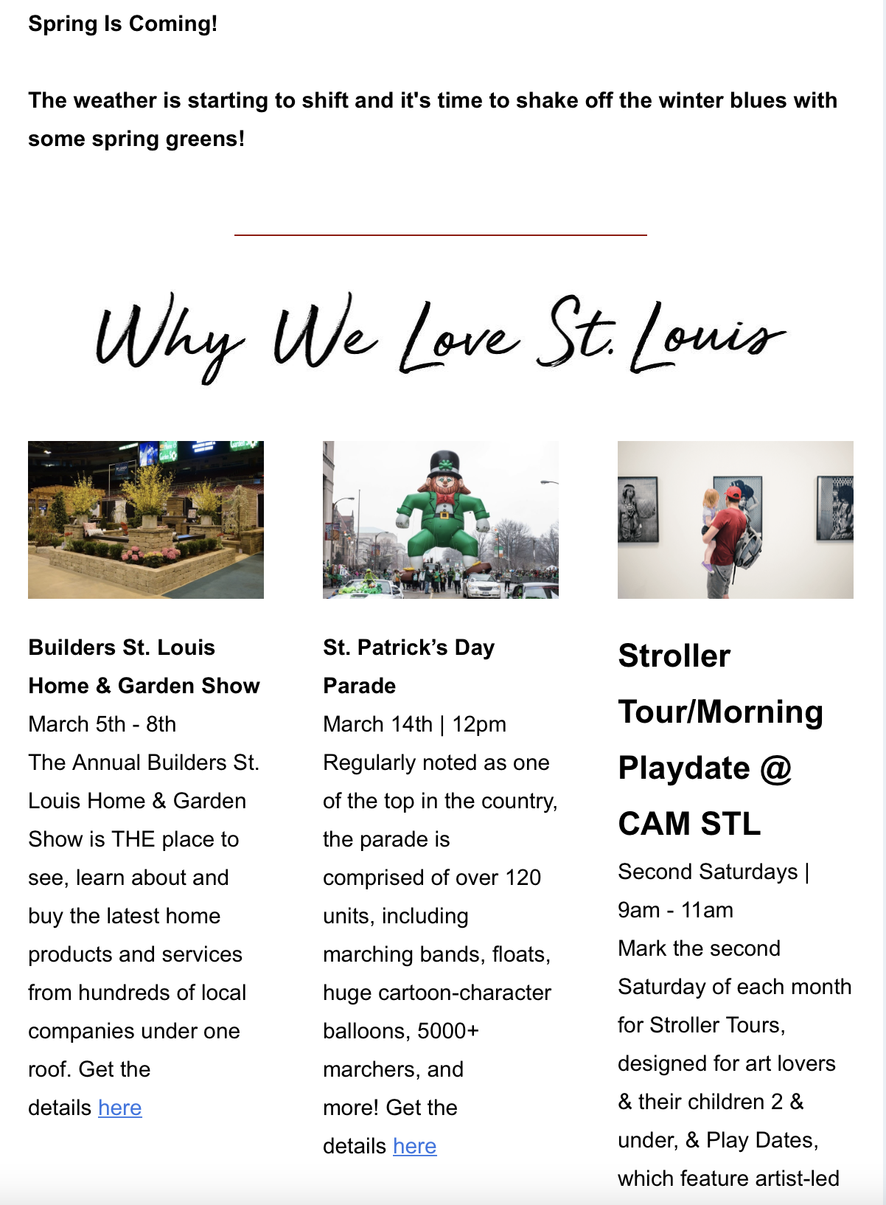
Study 1
Field Study: Real Estate Firm Email Campaign
Objective: Evaluate the proposed effects of crisis-related messages on consumption behavior (H1) by analyzing open email rates, clicks through rates, and click-to-open rates.
Sample and Procedure
Realty firm in the US
Total sample: 1,534 emails
Non-Crisis email campaign: March 03 (N = 782)
Crisis email campaign: March 17 (N = 752)
Main Variables
IV: Email type (crisis-related message = 1, non crisis-related message = 0)
DV: Open rates (open: yes = 1, no = 0)
DV: CTR rates (click: yes = 1, no = 0)
DV: CTOR (click: yes = 1, no = 0)
Non-Crisis Content
Crisis Content
Notes:
IMPORTANT: OUR RESEARCH SEEKS TO TEST that Hispanics’ positive response to health appeals congruent with their identity, is context dependent

Slide 10
Results
Open Rates
Binary logistic regression:
DV: Open rates (open: yes = 1, no = 0)
IV: Email type (crisis-related message = 1, non crisis-related message = 0)
B = .297, SE = .10, Wald χ2(1) = 8.24, p = .004
46% (39%) of the crisis-related (non crisis-related) delivered emails were opened.
60% (53%) of the non crisis-related (crisis-related) delivered emails were not opened.
CTR Rates
Binary logistic regression:
DV: CTR rates (click: yes = 1, no = 0)
IV: Email type (crisis-related message = 1, non crisis-related message = 0)
B = .725, SE = .31, Wald χ2(1) = 5.39, p = .020
4% (2%) of the crisis-related (non crisis-related) delivered emails were opened.
98% (96%) of the non crisis-related (crisis-related) delivered emails were not opened.
CTOR Rates
Binary logistic regression:
DV: CTOR rates (click: yes = 1, no = 0)
IV: Email type (crisis-related message = 1, non crisis-related message = 0)
B = .572, SE = .32, Wald χ2(1) = 3.23, p = .07
9% (5%) of the crisis-related (non crisis-related) delivered emails were opened.
95% (91%) of the non crisis-related (crisis-related) delivered emails were not opened.
Notes:
Model 7 PROCESS MACRO, Hayes (2018)

Slide 11
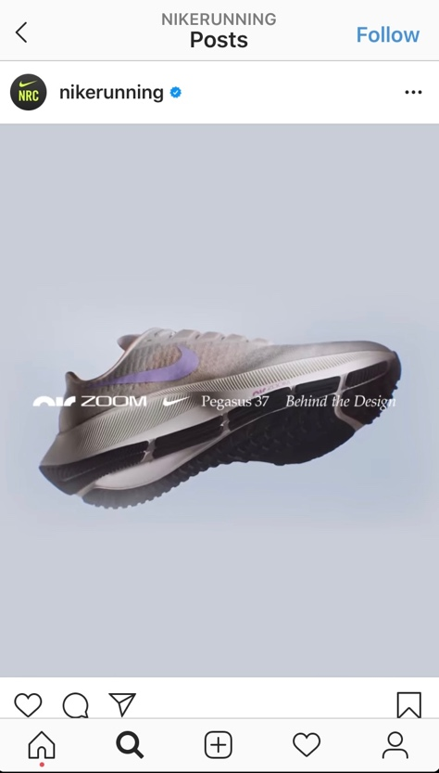
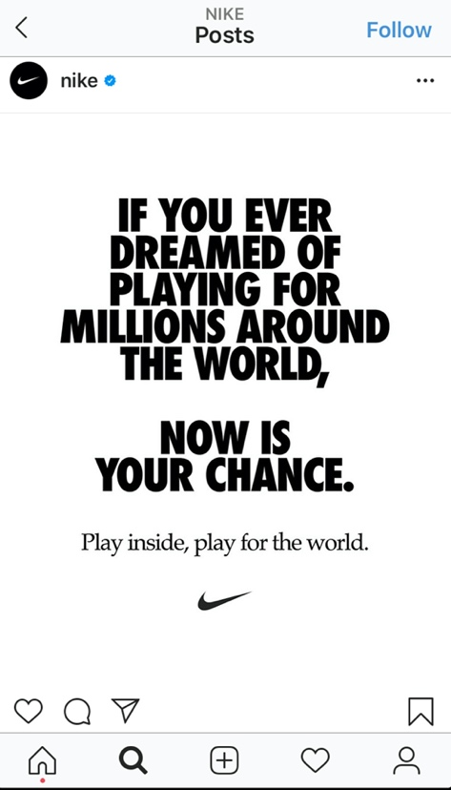
Study 2
Moderating role of social connections
Objective: Assess the predicted moderating role of social connections (H2)
Participants: 297 MTurk participants (58.9% Female, M_{age} = 38.01)
Design: 2 (message type: crisis / non-crisis) x 2 (social connection: continuous) between subjects design
Baseline opinions of Walmart and Nike brands (clicks and shares)
Post-stimuli opinions of Walmart and Nike brands (clicks and shares)
Main DV: Difference between post and baseline (clicks and shares)
Moderating Variable: Social connections (“how connected do you feel during this pandemic” and “how balanced do you feel your life is now (work/life)?” on 7-point bipolar measures “not at all” - “very much”)
Covariates: brand familiarity, purchase frequency, worry, coping, and social distancing protocols
Non-Crisis Content
Crisis Content
Notes:
IMPORTANT: OUR RESEARCH SEEKS TO TEST that Hispanics’ positive response to health appeals congruent with their identity, is context dependent

Slide 12
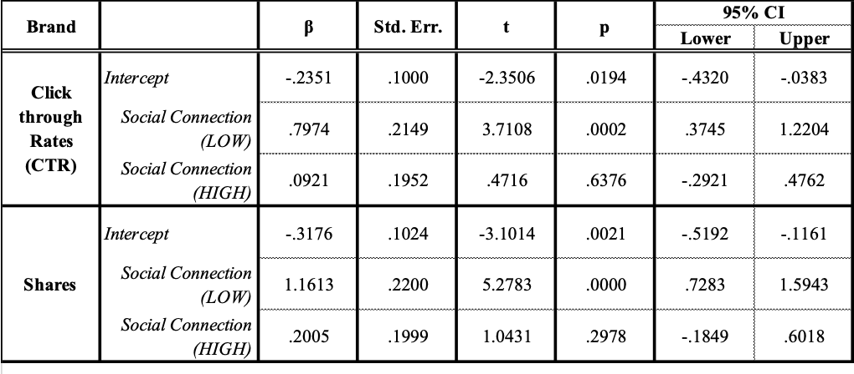
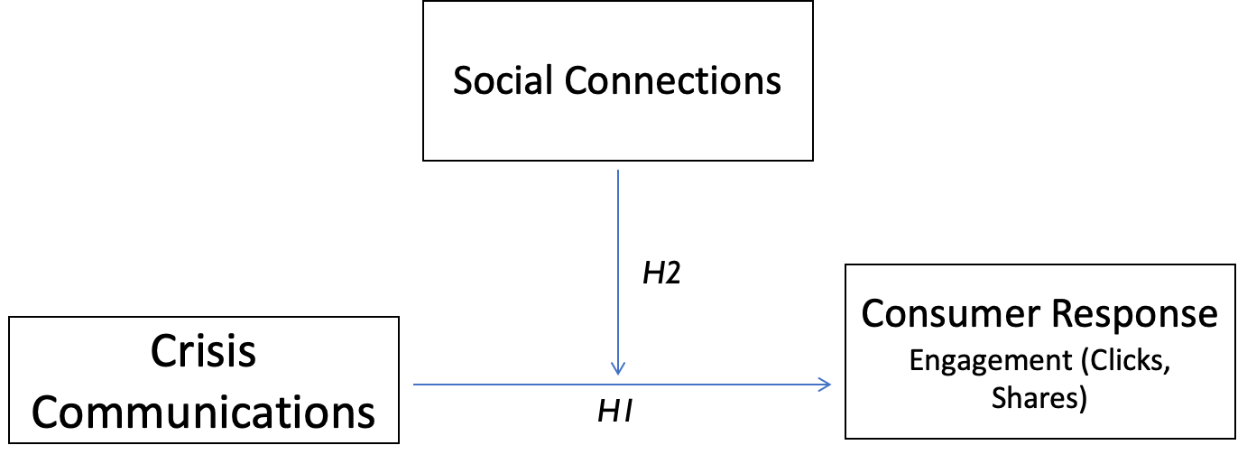
Study 2
Analysis of Conceptual Model: Moderation
Notes:
Model 7 PROCESS MACRO, Hayes (2018)

Slide 13
Study 2
Results

Slide 14
CONCLUSIONS & IMPLICATIONS
h “In a time of immense turmoil, people are turning to brands as islands of stability.” h - Richard Edelman
During a crisis, consumers brand engagement (CTR, CTOR, open rates, and shares) significantly increased compared to pre-crisis baseline engagement in response to brand crisis-related versus non-crisis related messages.
Findings ascertain the impact of brands getting involved in global events (crises) beyond their industry
Marketers can use this information to design marketing communications that especially target consumers with low social connections (excluded and vulnerable consumers)

Slide 15
Tessa Garcia-Collart, PhD l tgarcia-collart@umsl.edu

